Slide 1
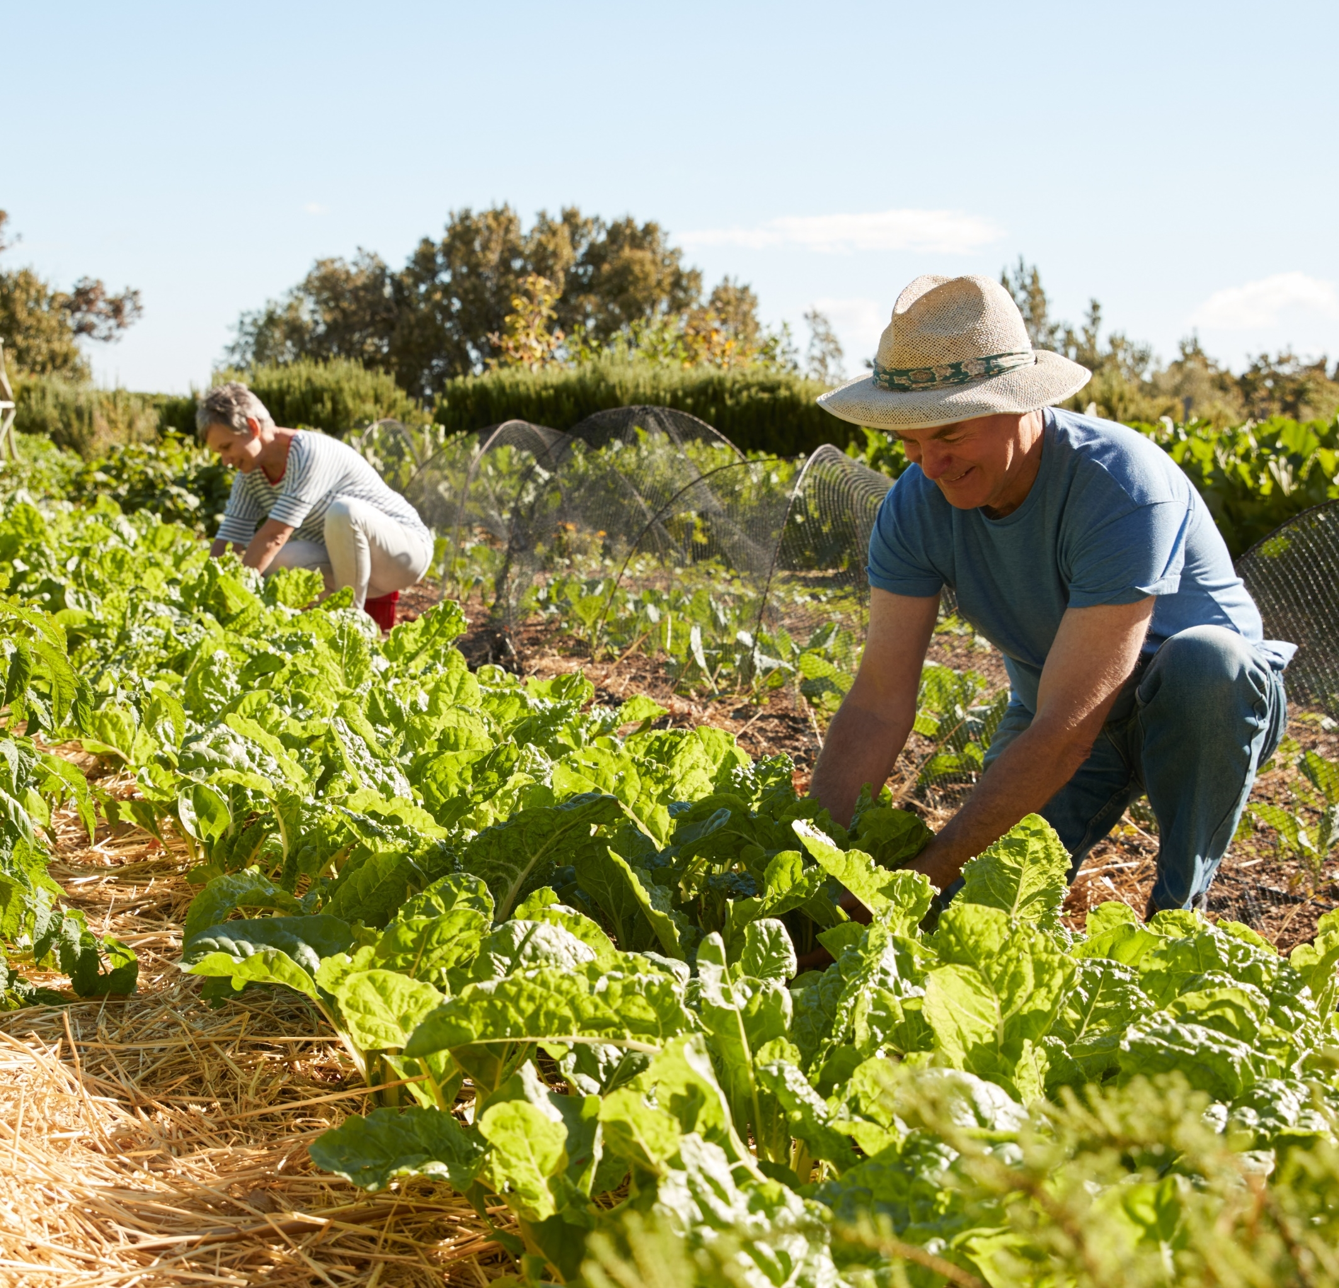
Agroforestry: Agriculture of the future? The case of Montpelier, France
What is the problem?
The agriculture sector in Montpellier is affected by high temperatures and frequent draughts
What is the solution?
As part of the SAFE project, an agroforestry scheme was adopted in Montepellier, based on a combination of walnut trees and wheat cultivation
What is the objective?
The objective of the scheme was to make the Montpellier agricultural systems more resilient to the effects of climate change
What are the benefits?
Environmental benefits
Reduced vulnerability to climate change, as trees provide shelter to crops and reduce damages due to high spring temperature
Creation of diverse habitat where wildlife species can live
Controlling pests and enhancing pollination
Carbon sequestration
Improved soil quality
Social benefits
Increased farmers’ products diversification
Higher farmers’ income
Maintaining land for future generation
Economic benefits
40% increase in productivity
Continuous revenue generation for farmers
Decreased dependence on crop subsidies

