Slide 1




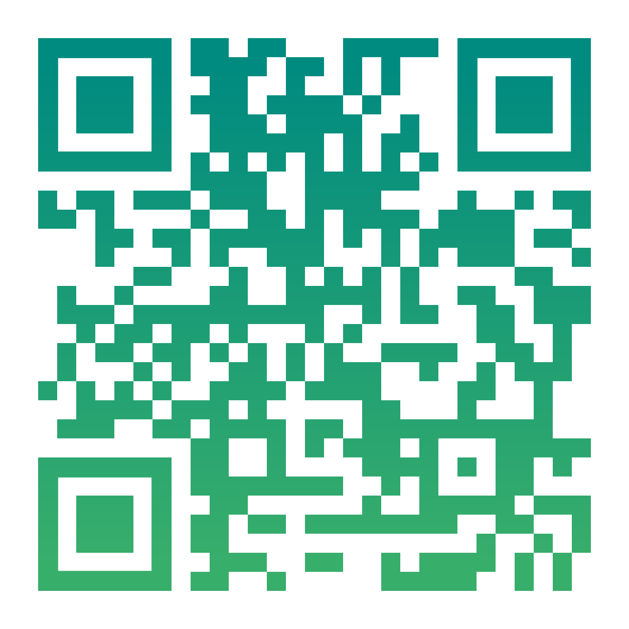
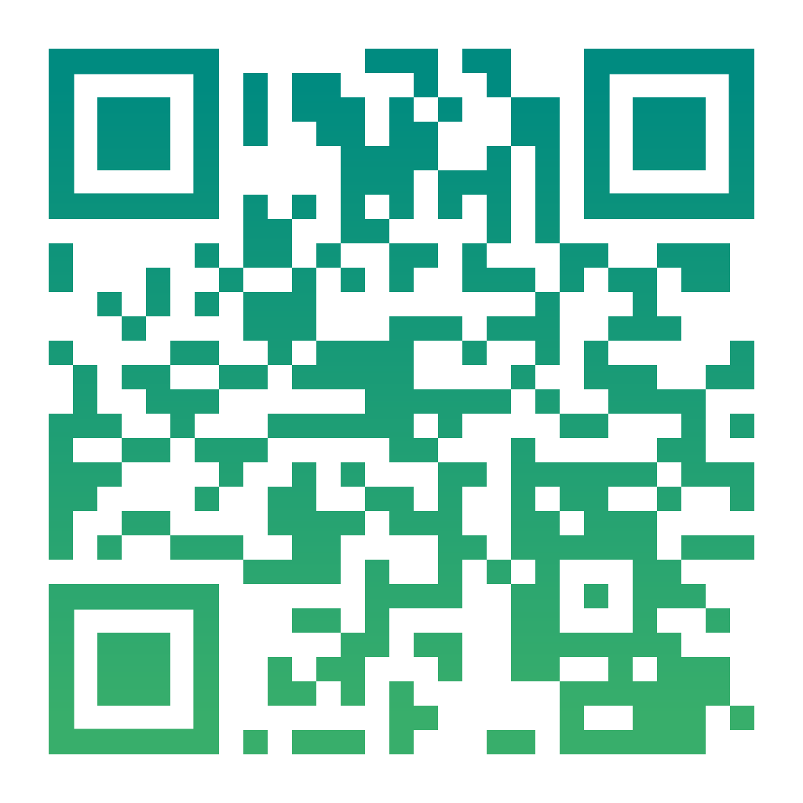



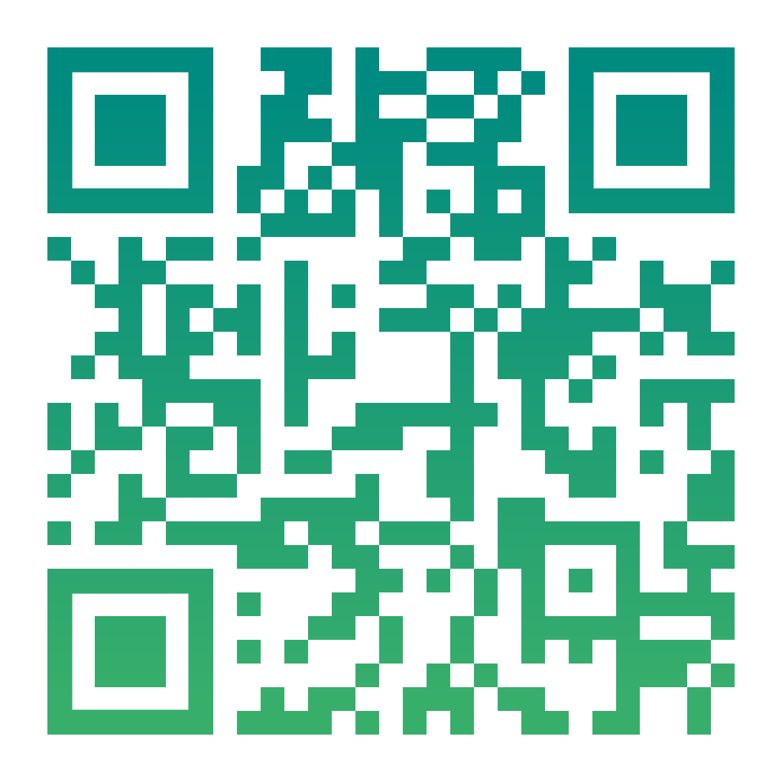
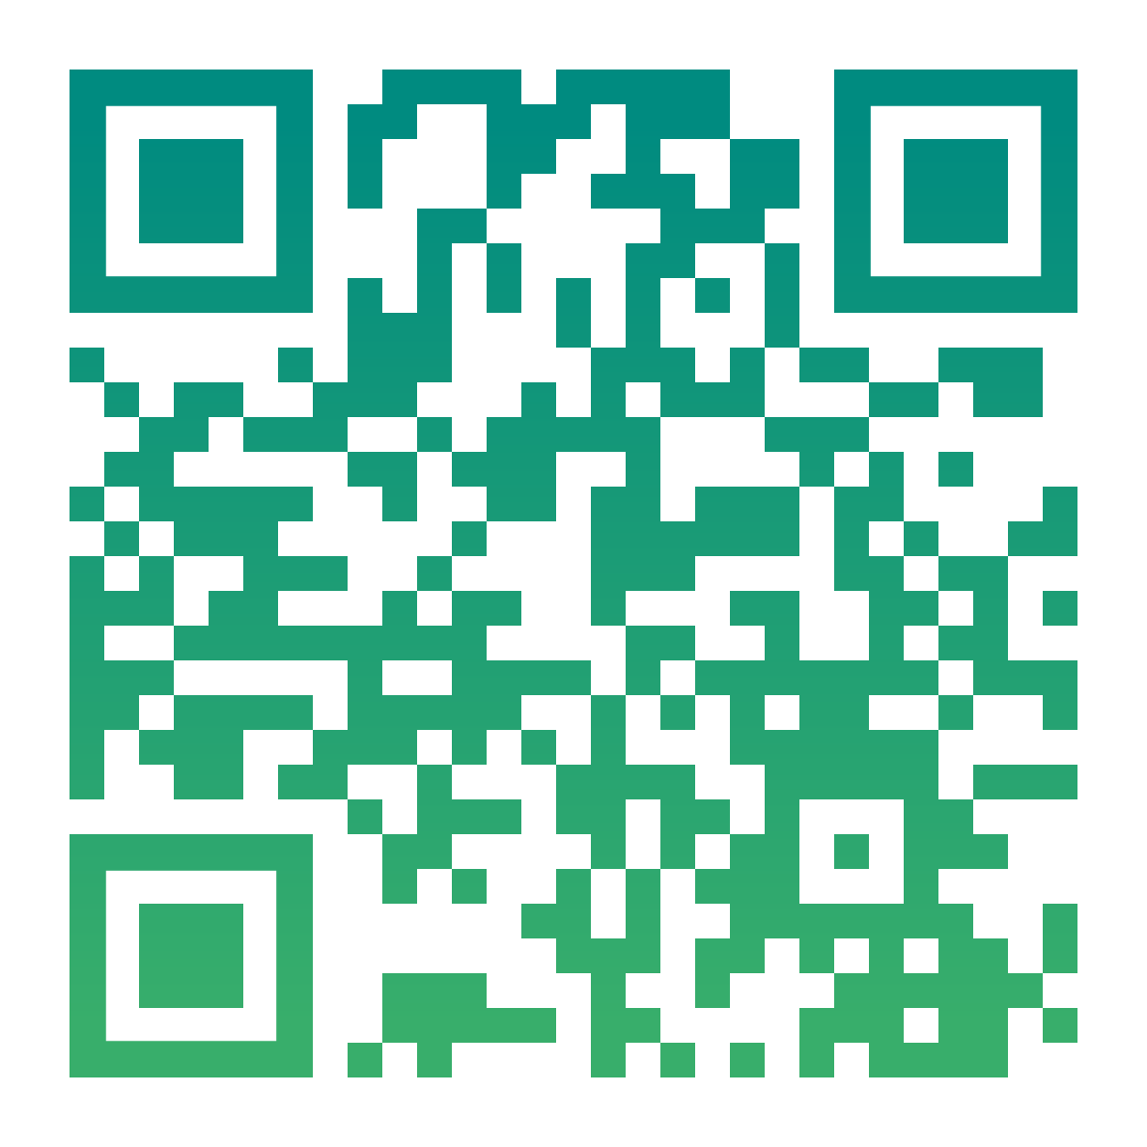
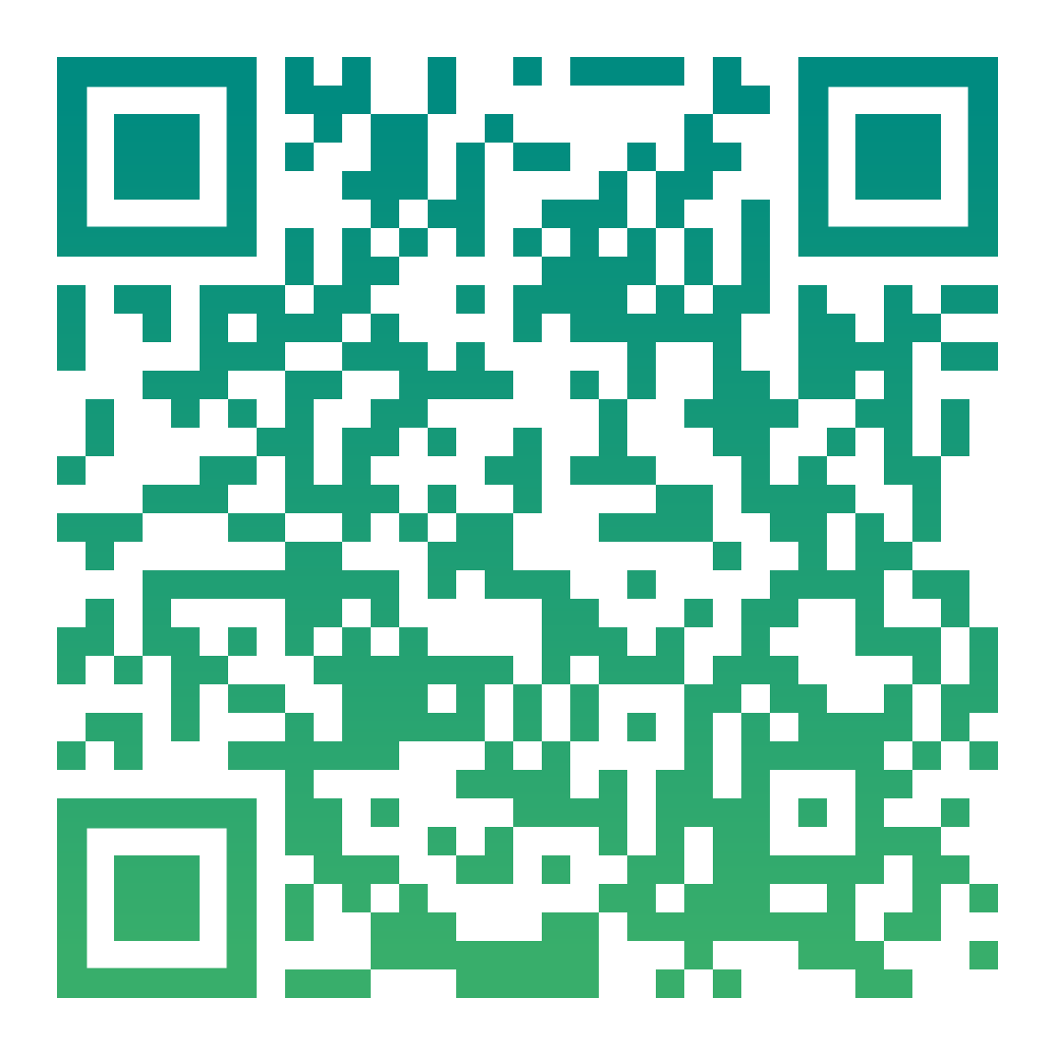
Follow us on our website & social media!
www.enabls.eu
@enabls-eu
@enabls_eu
@enabls.eu
@enabls_eu
@eNaBlS-eu

Slide 2
eNaBlS Fonts & Colour Palette
Fonts:
Titles: Calibri Light (main size: 36)
Main Body: Calibri (Body)
#026E7B
#008B80
#38AE6B
#97CA45

